Slide 1
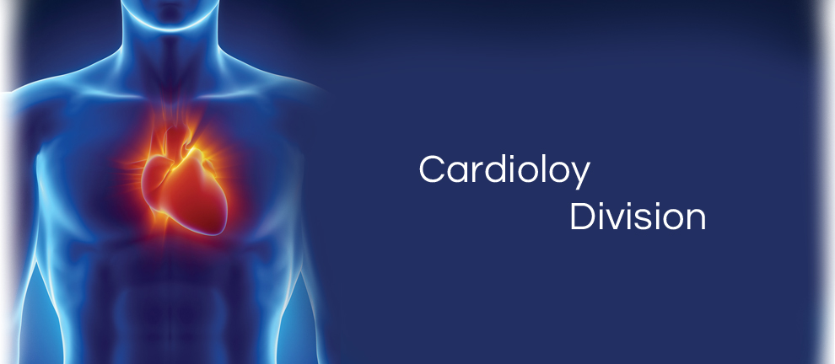
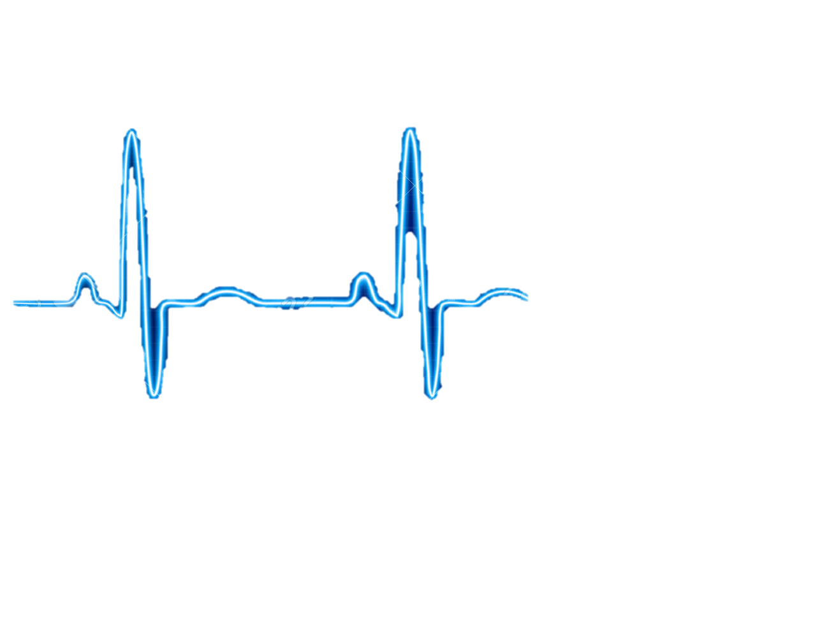
NEED FINDING
CARDIOVASCULAR TEAM
Qingbo Kang
Arthur Kohler
Chantelle Janeiro
Naghmeh Bandari
November, 2017

Slide 2
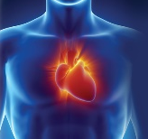

AGENDA
Team Members
Observations
Need Identification
Need Screening
Top Five Need Statements

Slide 3

TEAM MEMBERS
Naghmeh Bandari:
- PhD. Student of Mechanical engineering, Concordia University (2016-Now)
- Therapy Development Specialist, CoreValve® TAVI, Medtronic® lnc. (2010-2015)
- Commerce and Regulatory Affairs Supervisor, Thoratec Corp. (2007-2010)
Chantelle Janeiro:
Arthur Kohler:
Qingbo Kang:

Slide 4
Observation
5 Hospital Visits
Two general visits, Glen Hospital, with Dr. Galli
One Coronary Artery Bypass Grafting (CABG), Glen Hospital, with
Dr. Lachapelle, Dr. Cecere
Two Transcatheter Aortic Valve Implantation (TAVI), Glen Hospital
With Dr. Lachapelle, Dr. Piazza

Slide 5
Need Identification
Total number of identified needs: 99

Slide 6
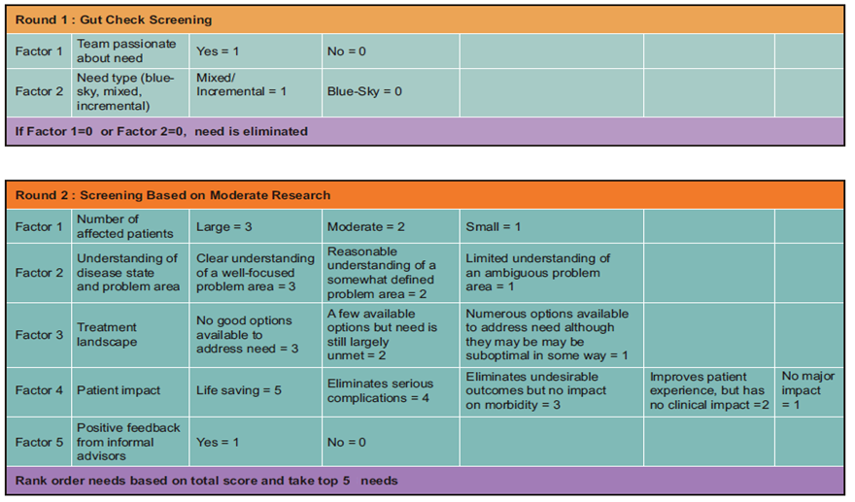
Number of Needs
Need Screening
99
25
5

Slide 7
Need 1:
A way to overcome the lack of wireless charging for medical devices that require an external power source, such as ventricle assist device, in patients with congestive heart failure, in order to improve convenience, maintenance, portability and quality of life.
Disease status:
Heart failure (HF) is a condition that the heart's pumping power is lower than healthy level. Consequently, the heart is not capable of pumping demanded oxygen and nutrients to the body.
At least 26 million patients worldwide
5.7 million people in the US
It is expected that by 2030 more than 8 million people will have this condition, with 46 % increase in prevalence

Slide 8
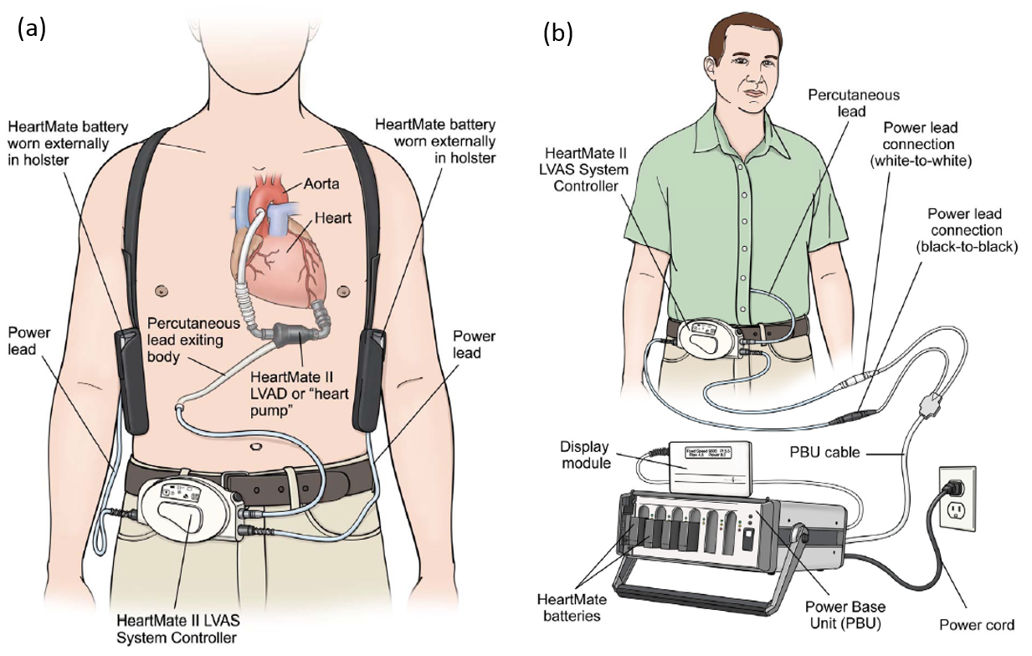
Need 1
Existing Treatment and Problem
Heart failure could be treated by Ventricle Assist Device (VAD), a small implantable device that act to compensate the pumping function of the heart and assist in circulating blood throughout the body.
VADs systems consist pump, system controller, power source, power leads, batteries and battery clips
VADs must always have power, either from batteries or electricity from the wall outlet
A power module or AC adaptor is used when the patient is not active, like when he is watching TV. It must be used when he is sleeping
Batteries should be exchanged when their charge falls below 25% capacity
Fully charged batteries should always be available or carried by backup bag

Slide 9
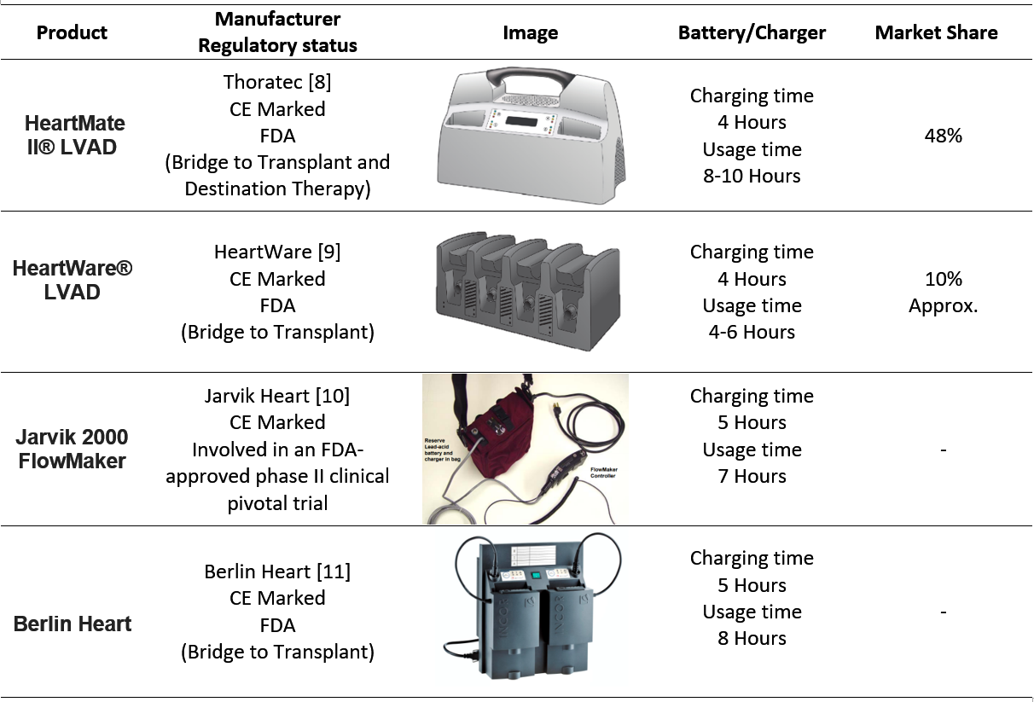
Need 1
Competitors

Slide 10
Need 1
Current Market for cardiac assistive devices
US | Global
770 Million | 1.4$ Billion | Market Value (2017)
10.9% | 8.6% | CAGR (2010-2017)
Classification and Applicable Regulations for battery chargers for VAD
FDA-CDRH | CE | HEALTH CANADA
Device Classification: 1 Product Code: KRF Regulation Number: CFR 870.3670 | Device Classification: I Regulation: EEC/2017/745 | Device Classification: I Regulation: CMDCAS
Need Criteria:
the proposed need is subjected to the following criteria:
Lightweight, easy to carry
No need to backpack for reserve battery set
Firmware to track flows and battery charge with phone application

Slide 11
Need 2:
Disease status:

Slide 12
Need 2
Existing Treatment and Problem

Slide 13
Need 2
Market and Competitors

Slide 14
Need 2
Classification and Applicable Regulations
FDA-CDRH | CE | HEALTH CANADA
Device Classification: 1 Product Code: Regulation Number: | Device Classification: I Regulation: EEC/2017/745 | Device Classification: I Regulation: CMDCAS
Need Criteria:

Slide 15
Need 3:
Disease status:

Slide 16
Need 3
Existing Treatment and Problem

Slide 17
Need 3
Market and Competitors

Slide 18
Need 3
Classification and Applicable Regulations
FDA-CDRH | CE | HEALTH CANADA
Device Classification: 1 Product Code: Regulation Number: | Device Classification: I Regulation: EEC/2017/745 | Device Classification: I Regulation: CMDCAS
Need Criteria:

Slide 19
Need 4:
Disease status:

Slide 20
Need 4
Existing Treatment and Problem

Slide 21
Need 4
Market and Competitors

Slide 22
Need 4
Classification and Applicable Regulations
FDA-CDRH | CE | HEALTH CANADA
Device Classification: 1 Product Code: Regulation Number: | Device Classification: I Regulation: EEC/2017/745 | Device Classification: I Regulation: CMDCAS
Need Criteria:

Slide 23
Need 5:
Disease status:

Slide 24
Need 5
Existing Treatment and Problem

Slide 25
Need 5
Market and Competitors

Slide 26
Need 5
Classification and Applicable Regulations
FDA-CDRH | CE | HEALTH CANADA
Device Classification: 1 Product Code: Regulation Number: | Device Classification: I Regulation: EEC/2017/745 | Device Classification: I Regulation: CMDCAS
Need Criteria:

Slide 27
CARDIOVASCULAR TEAM
Thank You…

